Slide 1
QF621 FX Quant Trading

Slide 2
FOREX advantages
minimal idiosyncratic risk
minimal country risk
minimal liquidity risk
higher AUM capacity
Short is allowed
Leveraging by nature

Slide 3
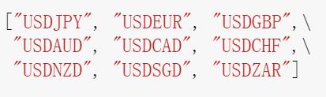
FOREX pairs
say both major and minor currencies (size risk factor),
some commodity-sensitive currencies (idiosyncratic risk),
and geometry-diversity currencies (country risk)

Slide 4
methodology
some trend following logic, as we are forming our strategy based on certain rolling windows
some risk based technic, as we are discussing on risk adjusted returns, and Value-at-Risk metrics
Some higher portfolio level money management, to identify on potential Regime change / failure of portfolio strategy

Slide 5
Portfolio formation
explore the behaviours on back-testing results by different sub-formations,
Higher Sharpe,
low PnL correlatio
Strategy formation on portfolio.
Equal weightage
Sharpe adjusted weightage
Risk adjusted weightage
Nomination wightage (may reserve cash portions)
2-strike VaR risk control.
2-strike stop loss
1-strike overloading

Slide 6
strategies
1. allocation: Max Return & Min Vol
3. Pairs trading
4. TA - RSI

Slide 7
Allocation Max Return / Min Vol
Consider momentum long short
Consider size long short
Efficiency frontier algorithm, min inverse Sharpe, min portfolio Std

Slide 8
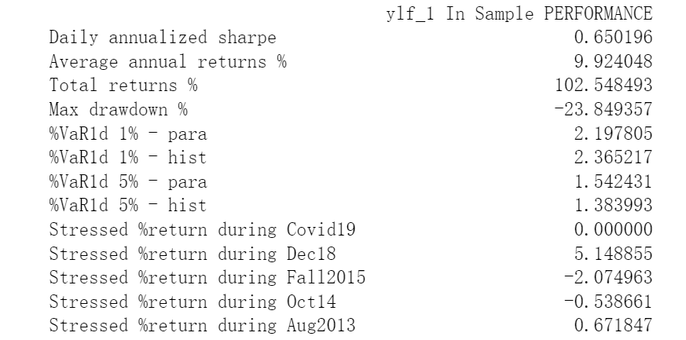
Allocation Max Return

Slide 9
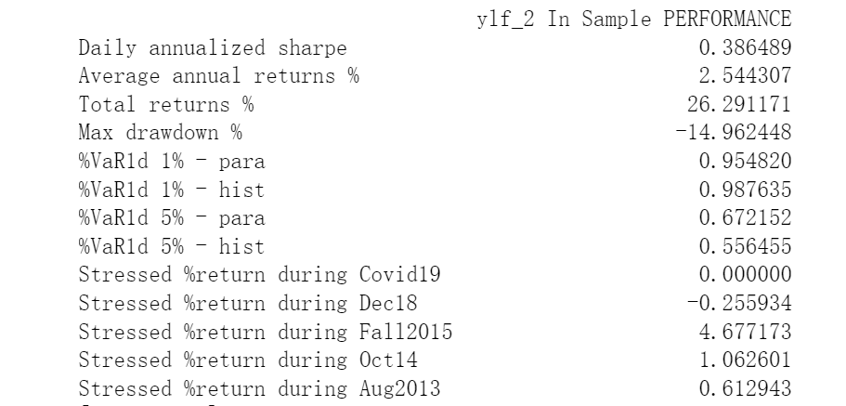
Allocation Min Vol

Slide 10
Pairs
Similarity measurement
Spread trading
De-coupling detection

Slide 11
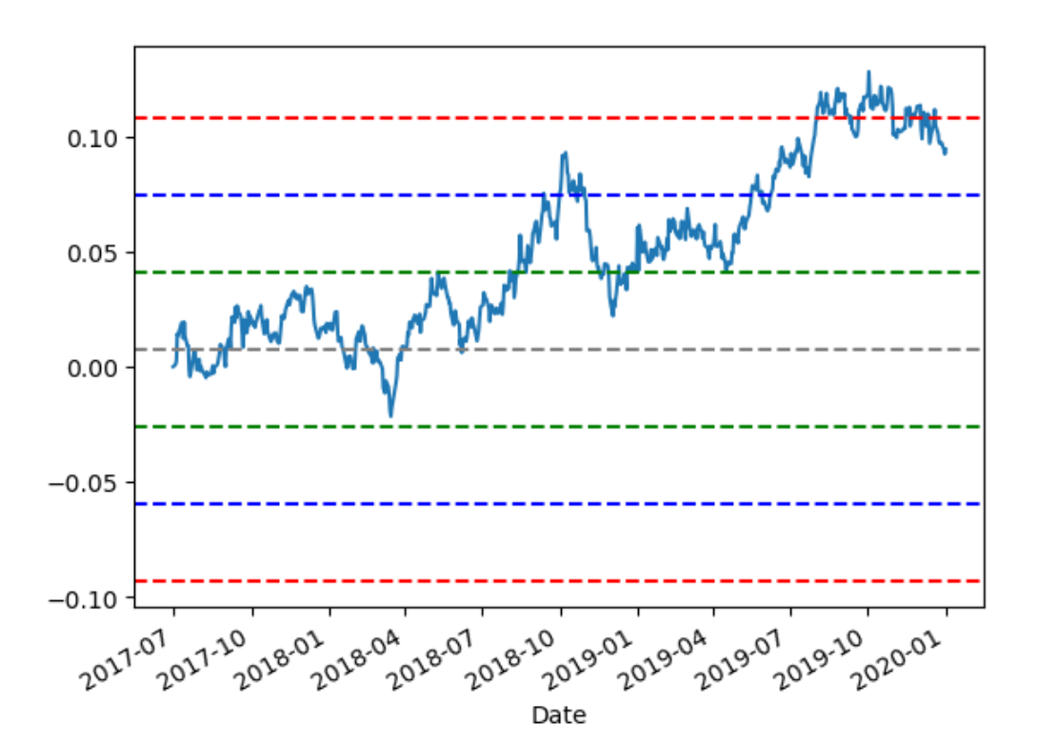
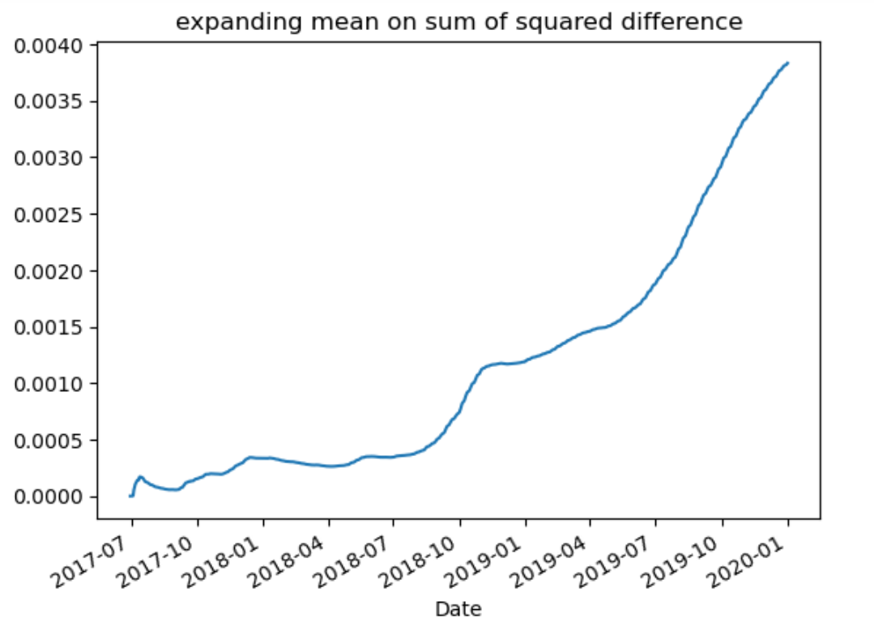
Effectiveness of spread trading

Slide 12
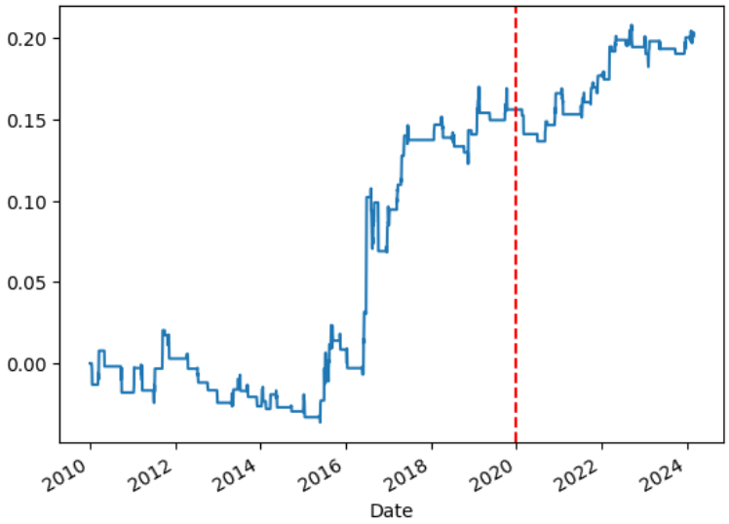
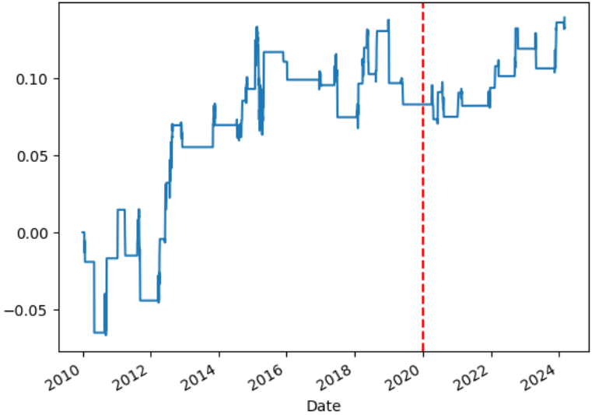
Pairs In-Sample performance samples

Slide 13
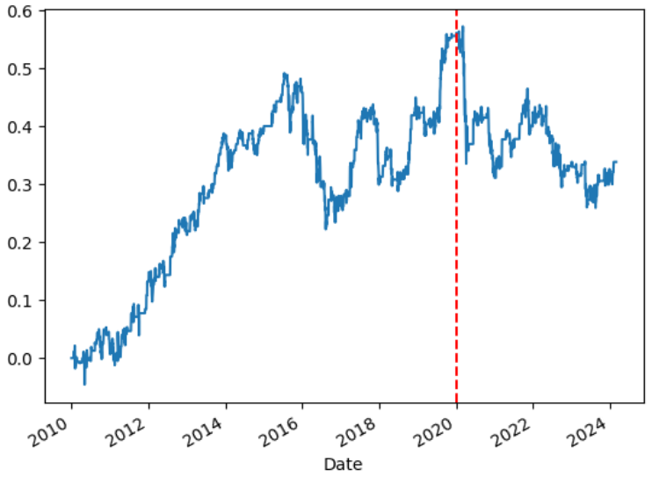
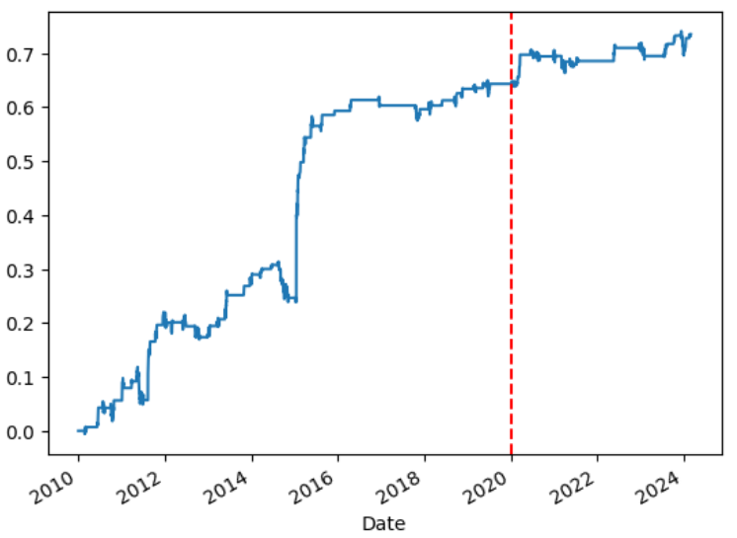
TA - RSI

Slide 14
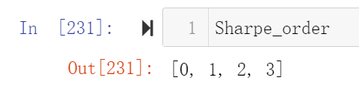
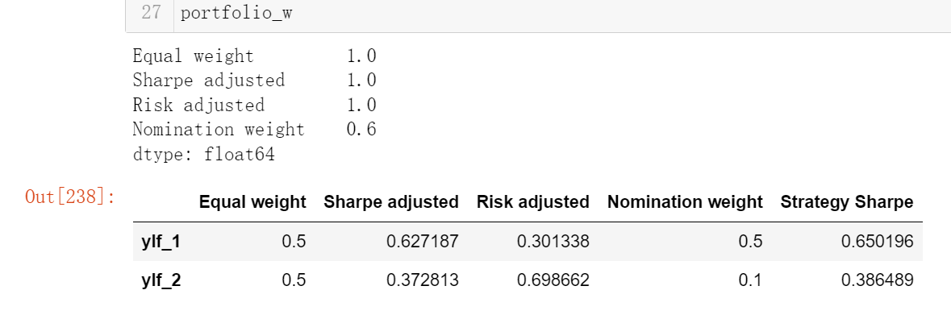
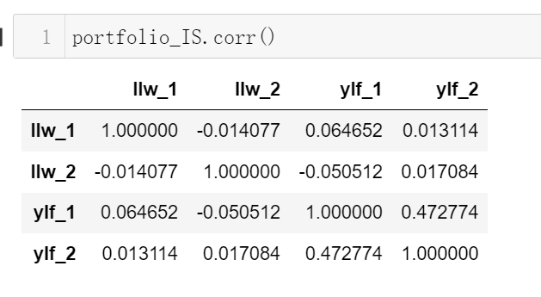
Portfolio strategy selection (to update)
Highest Sharpe first
Low corr threshold

Slide 15
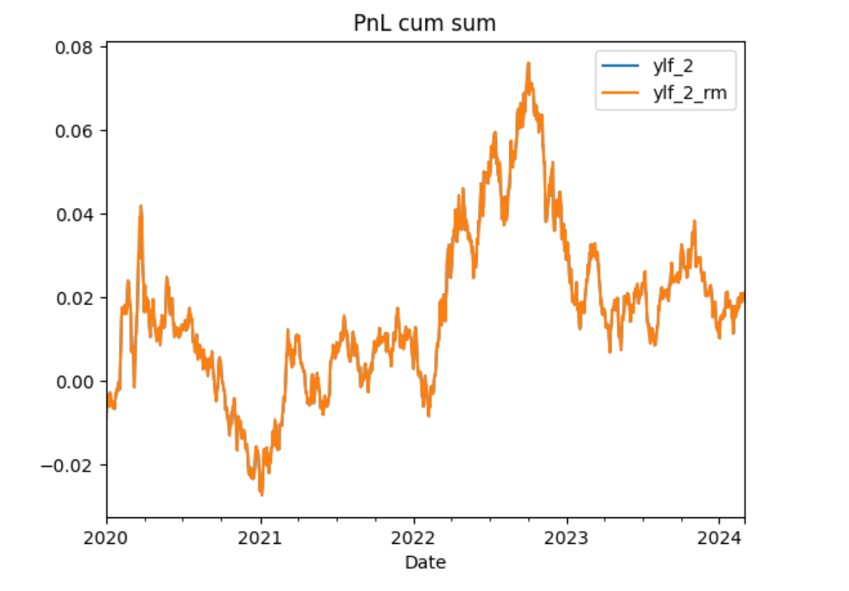
2-Strike risk control

Slide 16
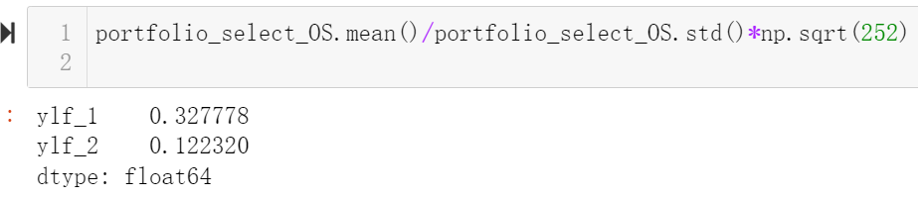
Individual Strategy Out of Sample Sharpe ratio

Slide 17
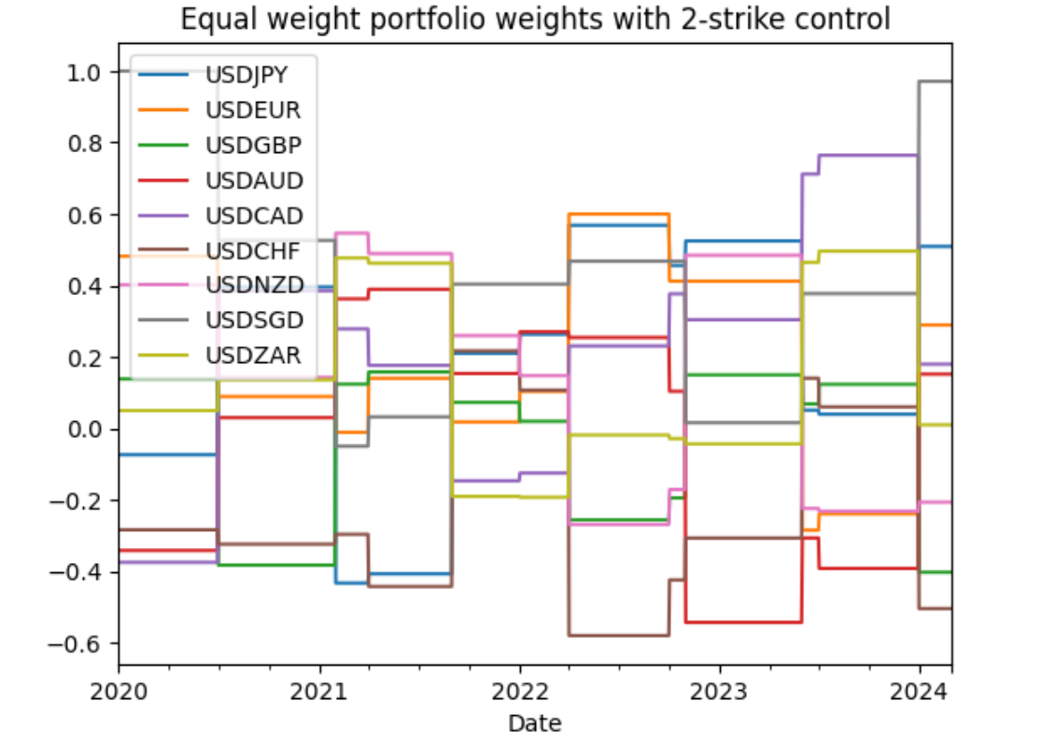
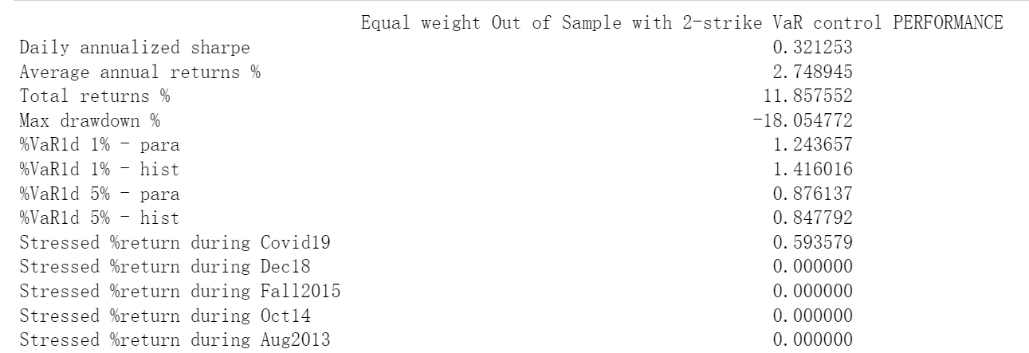
Final portfolio – equal weight

Slide 18
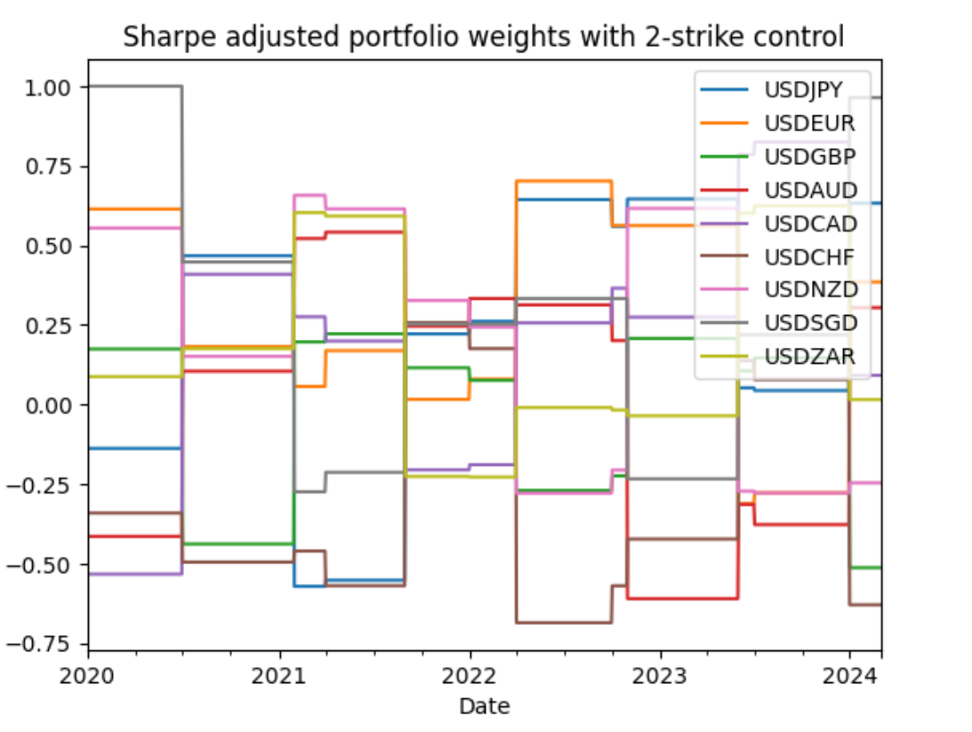
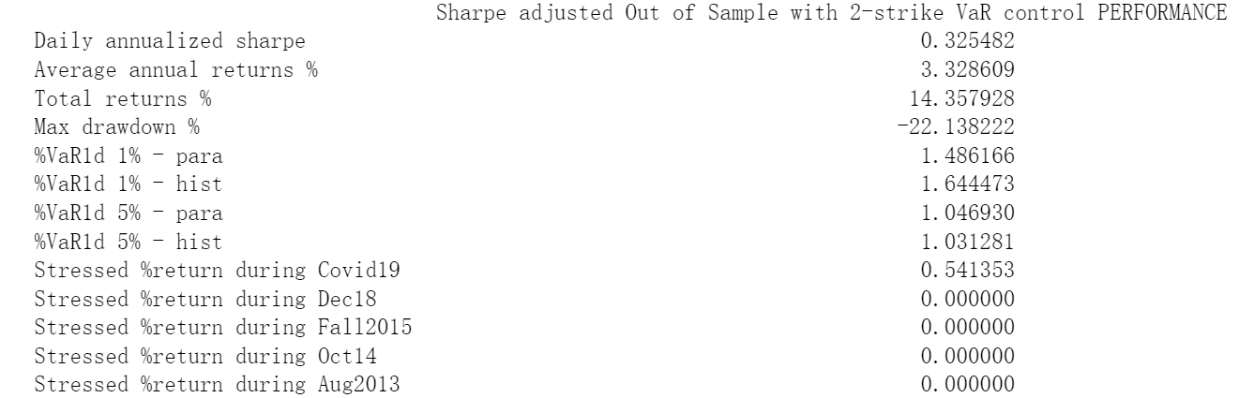
Final portfolio – sharpe adjusted

Slide 19
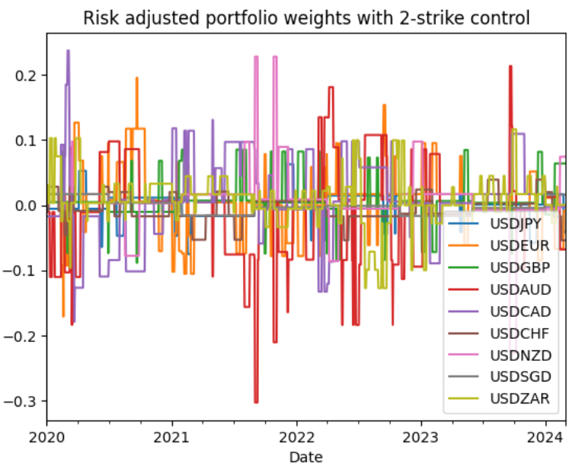
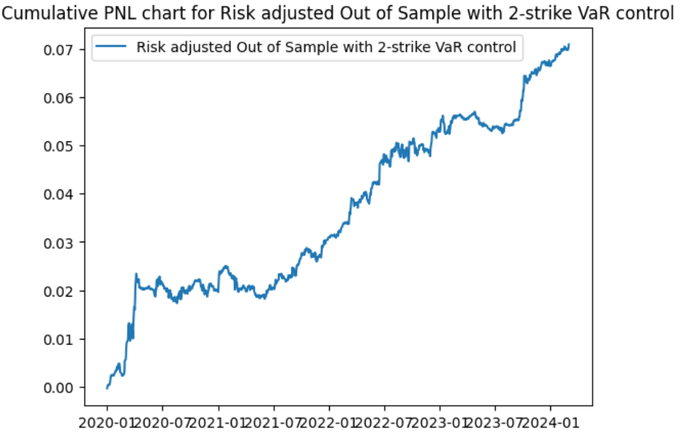
Final portfolio – risk adjusted

Slide 20
Conclusion – hedge fund
High Sharpe in-sample strategy
Low corr in-sample strategy
Weightage scheme
Risk control

